Slide 1
Systems Failure; how talent falls through the net
Gwenda Ward

Slide 2
The Emperor's New Clothes..
Declining participation
Declining standards
Declining numbers of volunteers
Disillusionment among volunteers
Extreme gender imbalance

Slide 3
You can’t identify or support talent without an adequate coaching workforce!

Slide 4
How many athletics coaches are there?
70,000 Sports Coach UK
21,000 Power of 10
12,500+ England Athletics
2,730 Association of British Athletics Clubs

Slide 5
Neither do we know……
What the geographical distribution is
What the event distribution is
What motivates them
How much time they put in
What their strengths and weaknesses are
What it costs them
Etc

Slide 6
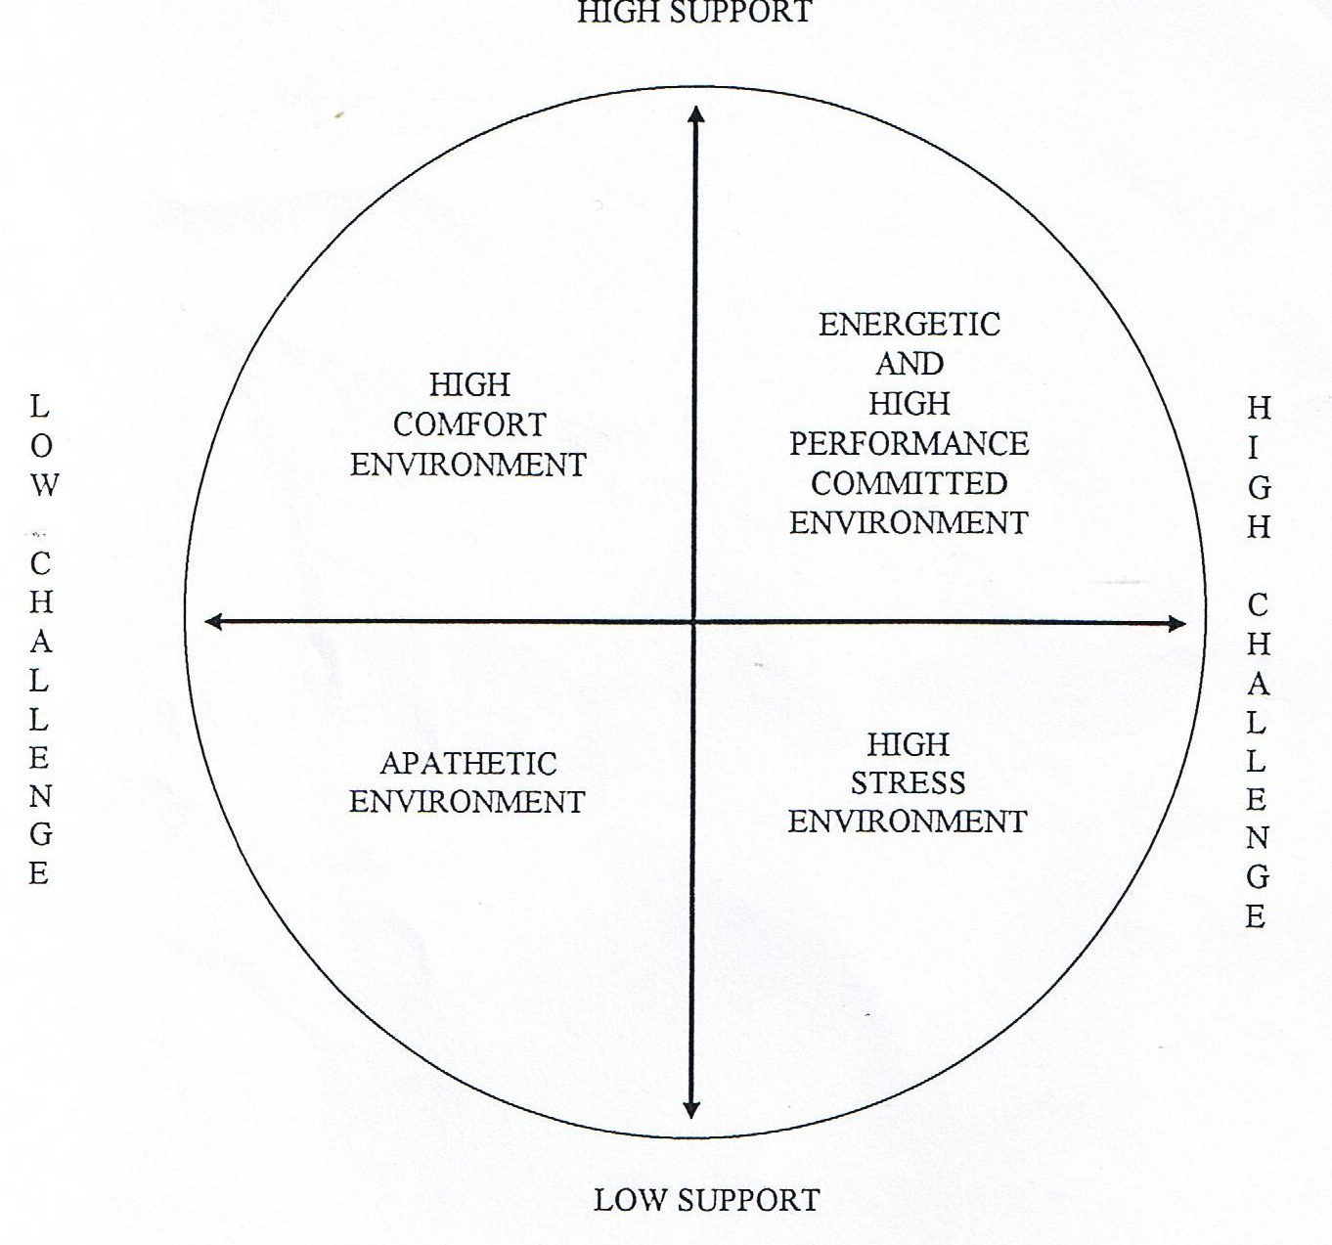
Supportive/challenging climate

Slide 7
Because its not just about numbers
The context of our employment affects the way we work
ESPECIALLY if the focus is technical
SO, WHAT ABOUT THE COACH/ATHLETE RELATIONSHIP?

Slide 8
Steps To Success
(Alma Thomas)
Step 4
Self Realization
Step 3
Self Confidence
Step 2
Self Control
Step 1
Self Discipline

Slide 9
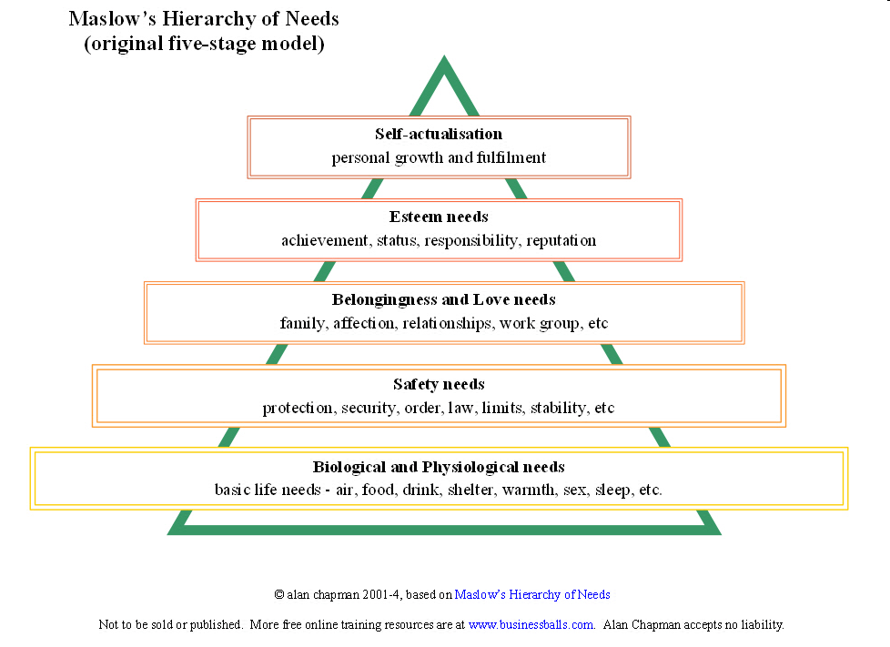

Slide 10
Acquired Needs Theory: McLelland
The need for achievement. Challenging but reachable goals; desire to do things better
The need for affiliation. Need harmonious relationships and to feel accepted; conformist
The need for power. A desire for personal power (control over others) is problematic. The need for social power (to attain organisational goals) is an attribute in managers. Power seekers can be more concerned with prestige than effectiveness

Slide 11
If we are serious about TALENT
Career pathways and opportunities
Security and respect
Ethical supervision and management
Supportive and challenging culture
Self awareness and self mgt. skills
Understanding of psychological needs

